Slide 1
Indirect Communication

Slide 2
The chapter examines a range of indirect communication techniques:
group communication, in which communication is via a group abstraction with the sender unaware of the identity of the recipients;
publish-subscribe systems, a family of approaches that all share the common characteristic of disseminating events to multiple recipients through an intermediary;
message queue systems, wherein messages are directed to the familiar abstraction of a queue with receivers extracting messages from such queues;
shared memory–based approaches, including distributed shared memory and tuple space approaches, which present an abstraction of a global shared memory to programmers.

Slide 3
Introduction
Researchers observed that
“All problems in computer science can be solved by another level of indirection.”
“There is no performance problem that cannot be solved by eliminating a level of indirection.”
Indirect communication: communication between entities in a DS through an intermediary with no direct coupling between sender and receiver(s).
it builds on our studies of inter process communication and remote invocation
Lots of variations in
Intermediary
Coupling
Implementation details and tradeoffs therein

Slide 4
Indirect communication (cont.)
In a direct coupling between a sender and a receiver (ipc, rmi), a certain amount of rigidity in the system in terms of dealing with change.
Consider a simple client-server interaction.
Because of the direct coupling, it is more difficult in Client-server interaction:
Hard to change server to one with same functionality
Harder to deal with failure

Slide 5
Indirect Communication
In contrast to direct communication, indirect communication avoids this direct coupling and hence inherits interesting properties.
The two key properties stemming from the use of an
intermediary:
Space uncoupling: in which the sender does not know or need to know the identity of the receiver(s), and vice versa. senders or receivers can be replaced, updated, replicated or migrated by system developer.
Time uncoupling: in which the sender and receiver(s) can have independent lifetimes.

Slide 6
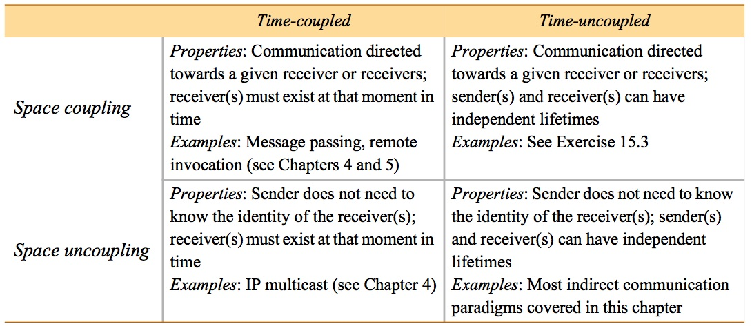
Space and time coupling in distributed systems

Slide 7
Group Communication
Group communication: Send messages to a group endpoint
Delivered to all members (modulo reliability guarantees)
Sender not aware of identity of receivers
An abstraction over multicast communication and may be implemented over IP multicast or an equivalent overlay network, adding significant extra value in terms of managing group membership, detecting failures and providing reliability and ordering guarantees.
With the added guarantees, group communication is to IP multicast what TCP is to the point-to-point service in IP.
Adds a lot of value
Detecting failures
Managing group membership (processes in the group)
Reliability guarantees
Ordering guarantees

Slide 8
Group Communication
Group communication represents an abstraction over multicast communication and may be implemented over IP multicast or an equivalent overlay network.
Group communication is to IP multicast what TCP is to the point-to-point service in IP.
Group communication can be exploited to provide
Simultaneous execution of the same operation in a group of workstations
Software installation in multiple workstations
Consistent network table management
Who needs group communication
Highly available servers
Conferencing
Cluster management
Distributed Logging….

Slide 9
Group Communication
Group communication is an important building block for distributed systems with key areas of application including:
The reliable dissemination of information to potentially large numbers of clients, including in the financial industry, where institutions require accurate and up-to date access to a wide variety of information sources;
Support for collaborative applications, where again events must be disseminated to multiple users to preserve a common user view
support for a range of fault-tolerance strategies,
Replicated data or the implementation of highly available (replicated) servers;
Support for system monitoring and management, including load balancing strategies.

Slide 10
Group Communication
Adds a lot of value
Detecting failures
Managing group membership (processes in the group)
Reliability guarantees
Ordering guarantees

Slide 11
Group Communication (Cont.)
Very useful building block for DSs, esp. reliable ones
Reliable dissemination of info to large # “clients” (esp. finance)
Collaborative applications: multiple users with common view
Wide range of fault-tolerance building blocks
Consistent update of replicated data
Highly available (replicated) servers
More on group communications next:
Programming models
Implementation issues

Slide 12
Programming model
Central abstraction: group & associated membership
Processes join (explicitly) or leave (explicitly or by failure)
Send single message to the group of N, not N unicast messages
Compare and contrast with IP multicast?
Early work started in the late 1980s, still going strong

Slide 13
Process groups and object groups
Most research on process groups
Abstraction: resilient process
Messages delivered to a process endpoint, no higher
Messages typically unstructured byte arrays, no marshalling etc
Level of service ≈ socket
Object group: higher level approach
Collection of objects (same class!) process same invocations
Replication can be transparent to clients
Invoke on single object (proxy)
Requests sent by group communication
Voting in proxy usually

Slide 14
Other key distinctions in group comm. services
Closed group: only members may multicast to it
Useful: coordinating among cooperating servers (usually replicas)
Open group: a process outside group may send to it
Useful: delivering events to interested parties, client request to server replica group
Overlapping groups: entities may belong to >1 group
Non-overlapping groups: 0 or 1 groups for an entity
Synchronous and asynchronous systems
Note: above has HUGE impact on multicast algorithms
Big reason why lots of research on this!
…. And that is even without Byzantine failure

Slide 15
Open and closed groups

Slide 16
Implementation issues
Reliable delivery
Unicast delivery reliability properties (note: not my favorite terms!)
Delivery integrity: message received same as sent, never delivered twice
Delivery validity: outgoing message eventually delivered
Group communication reliability properties build on this
Delivery integrity: deliver message correctly at most once to group members
Note: stronger than RPC delivery guarantees!
Delivery validity: message sent will be eventually delivered (if not all group members fail)
Agreement/consensus: Delivered to all or none of the group members
Note: also called atomic delivery

Slide 17
Ordered delivery
Possible strengths of ordering
FIFO ordering: first-in-first-out from a single sender to the group
Causal ordering: preserves potential causality, happens before (Chap 14)
Total ordering: messages delivered in same order to all processes
Perspective (not testable unless later covered…)
Strong reliability and ordering is expensive: scale limited
More probabilistic approaches & weaker delivery guarantees researched a lot last decade

Slide 18
Group membership management
Key elements
Provide interface for group membership changes
Failure detection
Notifying members of group membership changes
Sometimes with strong properties: virtual synchrony
Performing group address expansion

Slide 19
The role of group membership management
Group
address
expansion
Group
Leave
send
Multicast
Group membership
communication
Fail
management
Join
Process group

Slide 20
Case study: JGroups toolkit
Java API for reliable messages exchange.
It features a simple interface that provides:
a flexible protocol stack, including TCP and UDP
fragmentation and reassembly of large messages
reliable unicast and multicast
failure detection
flow control
Architecture
Channel: most primitive API
Building blocks: higher-level APIs built on top of channels
Protocol stack:

Slide 21
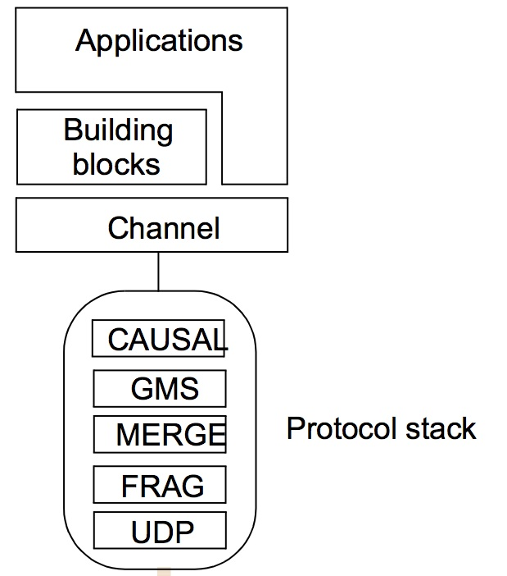
The architecture of JGroups

Slide 22
JGroups channels
Channel object: handle/reference for a group
Note: different from channel-based publish-subscribe (6.3.1)
Sends messages with some form of reliable multicast
Basic operations
connect to a named group
Leave a group: disconnect operation
close: shut down channel object
Other operations (admin stuff)
getView returns current member list
getState returns app state history

Slide 23
JGroups example
Simple example: intelligent fire alarm sends “Fire!” message to group
To raise the alarm:
FireAlarmJG alarm = new FireAlarmJG();
Alarm.raise();
To receive the alarm:
FireAlarmConsumerJG alarmCall = new FireAlarmConsumerJG();
String msg = alarmCall.await();
System.out.println(“Alarm received: “ + msg);

Slide 24
Java class FireAlarmJG
=====================================
import org.jgroups.JChannel;
public class FireAlarmJG {
public void raise() { // raise alarm, i.e. send “Fire!” message
try {
JChannel channel = new JChannel();
channel.connect("AlarmChannel"); // can create group
Message msg = new Message(null, null, "Fire!"); channel.send(msg);
}
catch(Exception e) {
}
}

Slide 25
Java class FireAlarmConsumerJG
import org.jgroups.JChannel;
public class FireAlarmConsumerJG {
public String await() {
try {
JChannel channel = new JChannel();
channel.connect("AlarmChannel");
Message msg = (Message) channel.receive(0);
return (String) msg.GetObject();
} catch(Exception e) {
return null;
}
}
}

Slide 26
JGroups building blocks & protocol stack
Building blocks examples
MessageDispatcher: sends msg, waits for (some) replies
RpcDispatcher: invokes a method on all objects, wait for replies
NotificationBus: distribited event bus, with any serializable Java object
Protocol stack (some,):
UDP: obvious, but uses IP multicast with UDP
FRAG: message fragmentation and reassembly
MERGE: deals with network partitioning (multiple versions)
GMS: group membership
CAUSAL: causal ordering
(lots of other protocols available: FIFO, total, discover, failure detection, encryption, flow-control, … & layers stack in any order)

Slide 27
Public-subscribe systems
publish–subscribe is a messaging pattern where senders is called publishers, do not program the messages to be sent directly to specific receivers, called subscribers, but instead categorize published messages into classes without knowledge of which subscribers, if any, there may be.
Similarly, subscribers express interest in one or more classes and only receive messages that are of interest, without knowledge of which publishers, if any, there are.
Message-oriented Middleware.
Most messaging systems support both the pub/sub and message queue models in their API, Example: Java Message Service

Slide 28
Public-subscribe systems
Publishers post messages to an intermediary message broker or event bus.
Subscribers register subscriptions with that broker, letting the broker perform the filtering. The broker normally performs a store and forward function to route messages from publishers to subscribers.
In addition, the broker may prioritize messages in a queue before routing.
Subscribers may register for specific messages at build time, initialization time or runtime.
Publisher and the subscriber rely on a message broker.

Slide 29
Key components of Pub/Sub System
Publishers : Publishers generate event data and publishes them.
Subscribers : Subscribers submit their subscriptions and process the events received
P/S service: It’s the mediator/broker that filters and routes events from publishers to interested subscribers.

Slide 30
Publish/Subscribe System

Slide 31
Public-subscribe systems
Though Pub/Sub is based on earlier design patterns like message queuing and event brokers, it is more flexible and scalable.
The key to this is the fact Pub/Sub enables the movement of messages between different components of the system without the components being aware of each other’s identity.

Slide 32
Public-subscribe systems
In publish-subscribe, messages are not directed towards individual services, but towards generalized subjects.
In other words: publishing components or services can evolve separately from their subscribing counterparts and both are only coupled to the event bus responsible for delivering published event to interested subscribers.
Publish-subscribe could be the first step of a decoupled, message-driven architecture and could aid in increasing (micro)service autonomy.

Slide 33
Public-subscribe systems
Pub-sub AKA distributed event systems
Most widely used from this chapter
Publishers publish structured events to event service (ES)
Subscribers express interest in particular events
ES matches published events to subscriptions
Applications (lots…)
Financial info systems
Other live feeds of real-time data (including RSS)
Cooperative working (events of shared interest)
Ubiquitous computing (location events, .... from infrastructure)
Lots of monitoring applications, including internet net. mon.
Key part of Google infrastructure (chap 21)

Slide 34
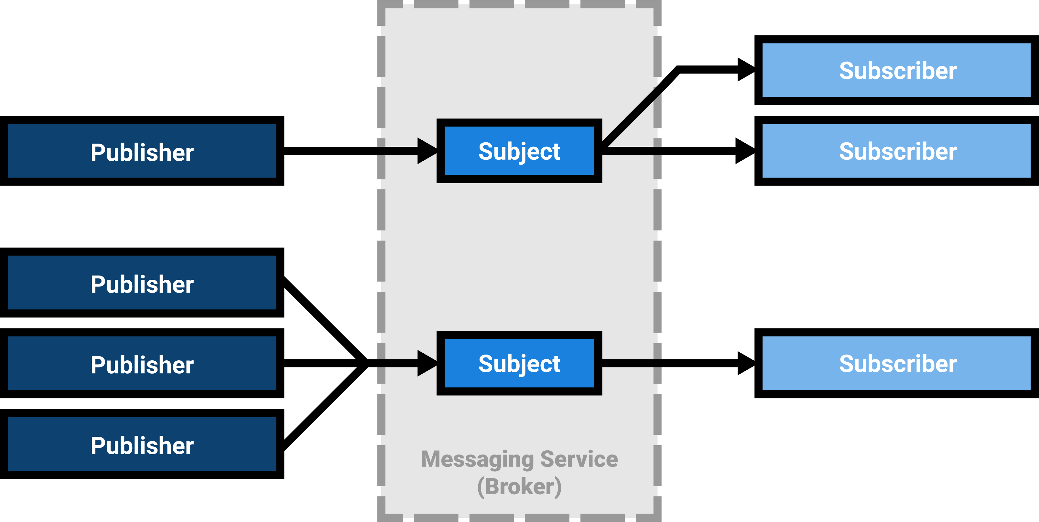
Public-subscribe systems

Slide 35
Key functions implemented by P/S middleware service
Event filtering (event selection)
The process which selects the set of subscribers that have shown interest in a given event. Subscriptions are stored in memory and searched when a publisher publishes a new event.
Event routing (event delivery)
The process of routing the published events from the publisher to all interested subscribers

Slide 36
Example: dealing room system
Example: dealing room for stock trading
Let users see latest market prices of stock they care about
Info for a given stock arrives from multiple sources
Dealers only care about stocks they own (or might)
May only care to know above some threshold, in addition
Possible structure: two (kinds of) tasks
Info provider process receives updates (events) from a single external source
Dealer process creates subscription for each stock its user(s) express interest in

Slide 37
Dealing room system
Dealer’s computer
External
Dealer’s computer
source
Dealer
Notification
Notification
Dealer
Notification
Information
provider
Notification
Notification
Notification
Notification
Dealer’s computer
Dealer’s computer
Notification
Information
provider
Notification
Dealer
Notification
Dealer
External
source

Slide 38
Characteristics of pub-sub systems
Heterogeneity
Able to glue together systems not designed to work together, with pub-sub technology
Have to come up with an external description of what can be subscribed to: simple flat, rich taxonomy, etc
Asynchrony
Decoupling means you never have to block!
Possible delivery guarantees
All subscribers receive all events (atomicity)
Real-time
…

Slide 39
Pub-sub programming model
Publishers
Disseminate event e through publish(e)
(Sometimes, fancier) register/advertise via a filter (pattern over all events) f : advertise (f)
Expressiveness of pattern is the subscription model (later slide)
Can also remove the offer to publish: unadvertise (f)
Subscribers
Subscribe via a filter (pattern) f: subscribe(f)
Receive event e matching f: notify(f)
Cancel their subscription: unsubscribe(f)

Slide 40
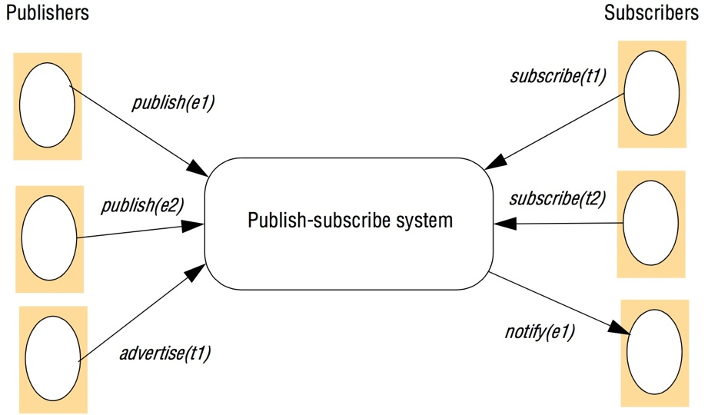
The publish-subscribe paradigm

Slide 41
Subscription models of pub-sub systems
Channel-based
Publishers publish to named channels
Subscribers get ALL events from channel
Very simplistic, no filtering (all other models below do)
CORBA Event Services uses this (DDS precursor)
Topic-based (AKA subject-based)
Each notification expressed in multiple fields, one being topic
Subscriptions choose topics
Hierarchical topics can help (e.g., old USENET rec.sports.cricket)

Slide 42
Subscription models of pub-sub systems (cont.)
Content-based
Generalization of topic based
Subscription is expression over range of fields (constraints on values)
Far more expressive than channel-based or topic-based
Type-based
Use object-based approaches with object types
Subscriptions defined in terms of types of events
Matching in terms of types or subtypes of filter
Ranges from coarse grained (type names) to fine grained (attributes and methods of object)
Advantage: clean integration with object-based programming languages

Slide 43
Subscription models of pub-sub systems (cont.)
Other kinds
Objects of interest: like type-based, but on change in state of object
For mobile: also match based on context
Concept-based subscriptions: not just syntax, but semantics of events.
Fancier (e.g., financial trading): complex event processing (CEP)
Patterns between different events, locations, time, ..
I.e. patterns can be logical, temporal, or spatial
For more, see ACM’s Distributed Event-Based Systems (DEBS) conference

Slide 44
Implementation issues
Many ways to delivery events efficiently to subscribers
Also can be requirements for security, scalability, failure handling, concurrency, QoS
A number of key implementation choices follow..

Slide 45
Centralized vs. distributed implementations
Simple way: single centralized broker node
Most implementations are network of brokers
E.g., GridStat
Some implementations are peer-to-peer (P2P)
All publisher and subscriber nodes act as the pub-sub broker
E.g., RTI DDS

Slide 46
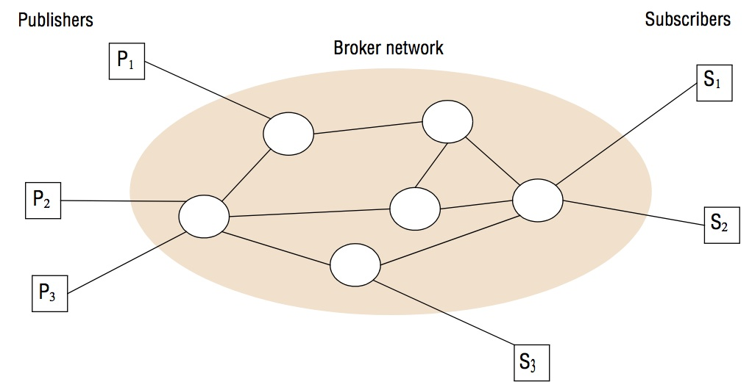
A network of brokers

Slide 47
Overall systems architecture
Centralized schemes simple…
Implementing channel-based or topic-based simple
Map channels/topics onto groups
Use the group’s multicast (possibly reliable, ordered, ..)
Implementation of content/type/ more complicated
Ranges of choices follow in fig 6.10

Slide 48
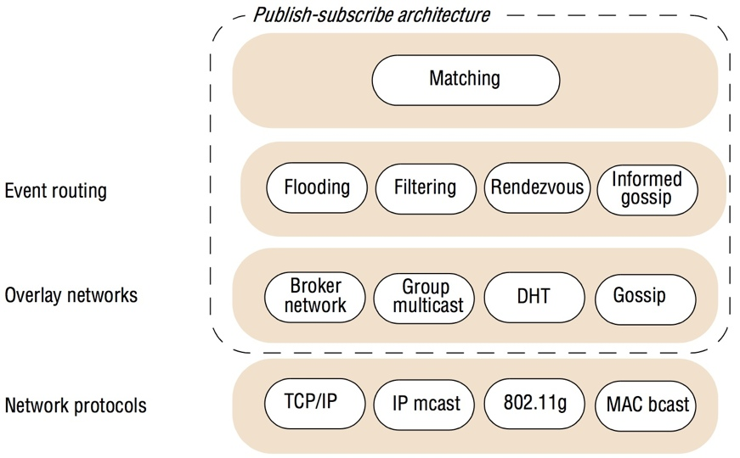
The architecture of publish-subscribe systems

Slide 49
Implementation choices in content-based routing (CBR)
Flooding (with duplicate suppression)
Simplest version
Send event to all nodes on a network
Can use underlying multicast/broadcast
More complicated
Brokers arranged in acyclic forwarding graph
Each node forwards to all its neighbors (except one that sent it to node)
Filtering (filter-based routing)
Only forward where path to valid subscriber
I.e., subscription info propagated through network towards publ’s
Detail:
Each node maintain neighbors list
For each neighbor, maintain subscription list/criteria
Routing table with list of neighbors and subscribers downstream

Slide 50
Filtering-based routing
upon receive publish(event e) from node x 1
matchlist := match(e, subscriptions) 2
send notify(e) to matchlist; 3
fwdlist := match(e, routing); 4
send publish(e) to fwdlist - x; 5
upon receive subscribe(subscription s) from node x 6
if x is client then 7
add x to subscriptions; 8
else add(x, s) to routing; 9
send subscribe(s) to neighbours - x; 10

Slide 51
Implementation choices in CBR (cont.)
Advertisements
propagate advertisements towards subs’ (symmetrical to filtering)
Rendezvous
Consider set of possible events as an event space
Partition event space among brokers in net. (rendezvous nodes)
SN(s): for given subscrip. s, returns set of nodes responsible for it
EN(e): for event e, rtn list of nodes that match e against subscriptions
Mapping intersection rule: SN(s)∩ EN(e) must be nonempty if e matches s
Distributed hash table (DHT) variant: map events and subscriptions onto a rendezvous nodes via DHT (Sec 4.5.1)
Routing can be done via gossiping (epidemic multicast)

Slide 52
Rendezvous-based routing
upon receive publish(event e) from node x at node i
rvlist := EN(e);
if i in rvlist then begin
matchlist :=match(e, subscriptions);
send notify(e) to matchlist;
end
send publish(e) to rvlist - i;
upon receive subscribe(subscription s) from node x at node i
rvlist := SN(s);
if i in rvlist then
add s to subscriptions;
else
send subscribe(s) to rvlist - i;
Instructor’s Guide for Coulouris, Dollimore and Kindberg Distributed Systems: Concepts and Design Edn. 4 © Pearson Education 2005

Slide 53
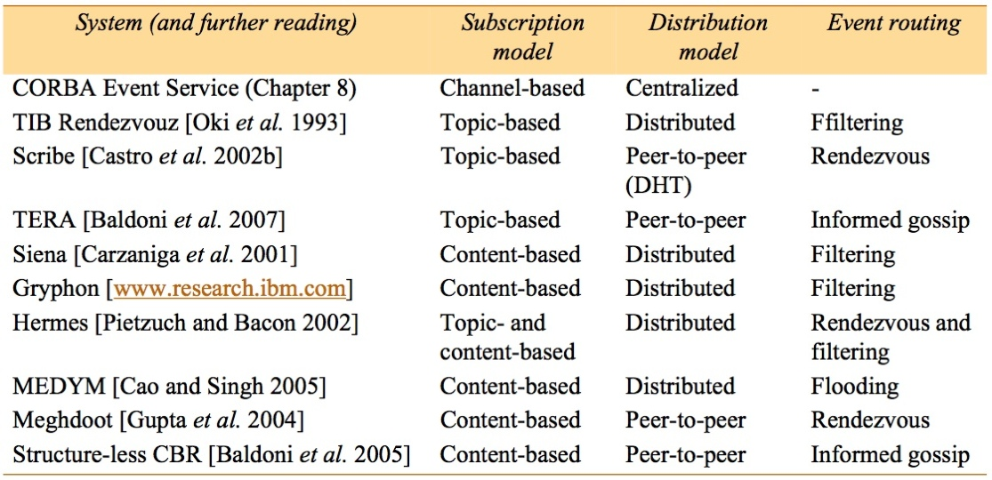
Example publish-subscribe system

Slide 54
Message queues
(Distributed) message queues: intermediary between producers and consumers of data
Point-to-Point, not one-to-many
Supports time and space uncoupling
AKA Message-Oriented Middleware (MOM)
LOTS of commercial products
Main use: Enterprise Application Integration (EAI)
Also a lot for transactions (6.4.1)
Programming model: producer sends msg; consumers can
Blocking receive
Non-blocking receive (polling)
Notify

Slide 55
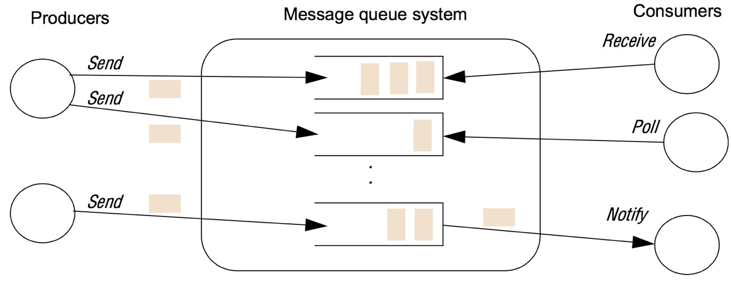
The message queue paradigm

Slide 56
Programming model (cont.)
Many processes can send to a queue, many can remove from it
Queuing policy: usually FIFO, but also priority-based
Consumers can select based on metadata
Database integration common use; e.g. Oracle AQ
Messages are a row in a (relational) database
Queues are database tables that can be SQL-queried against

Slide 57
Programming model (cont)
Messages are persistent
Store until removed
Store on a disk
Other common functionality
Transaction support: all-or-none operations
Automatic message transformation: on arrival, message transforms data from one format to another (data heterogeneity)
Security (at least confidentiality)

Slide 58
Implementation issues
Key choice: centralized vs. distributed implementation
Case study: IBM Websphere MQ
Queue managers host and manage queues, enable apps to access via Message Queue Interface (MQI)
Connect or disconnect to/from a queue
Send/receive messages to/from a queue (via a RPC call)
Clients not on same host (usual case) vi a client channel (w/proxy+stub)

Slide 59
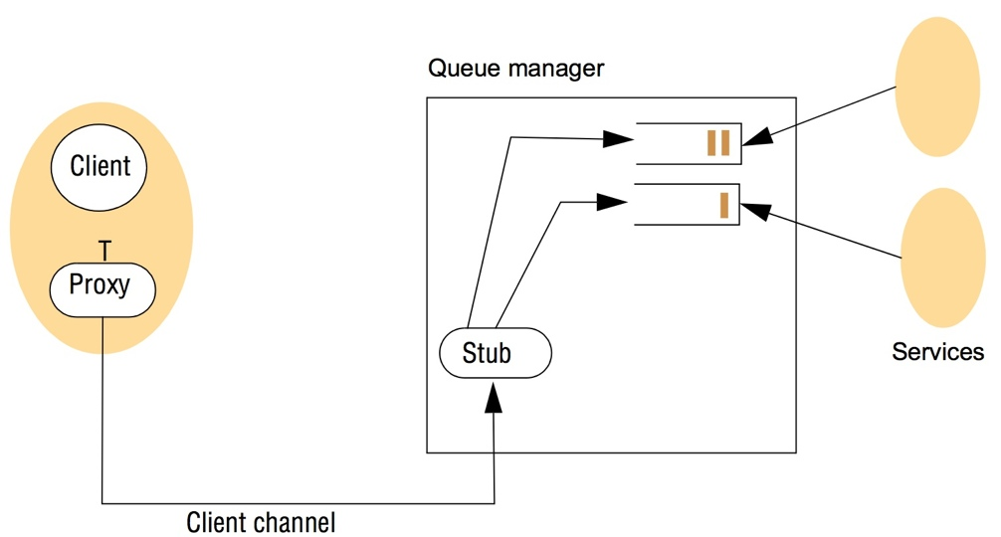
A simple networked topology in WebSphere MQ

Slide 60
IBM WebSphere (cont.)
Queues usually linked into a federated structure
Resembles pub-sub, but choose right topology for app
Queues linked with message channel(MC)
Message channel agent (MCA) manages each end of MC
Queue managers have routing tables
Lots of tools to create different topologies, manage components, etc
Hub-and-spoke topology (common)
Hub has lots of services (and resources to support)
Spoke queues are distant, place close(r) to clients
Clients interface with spoke queues

Slide 61
Case study: Java Messaging Service (JMS)
JMS supports both pub-sub and MQs
Many vendors; others provide interface (e.g., WebSphere)
Key roles in JMS
JMS client: Java app that produces or consumes messages
JMS producer: creates a message and places in a queue
JMS consumer: removes a message from a queue and uses it
JMS provider: any system that implements the JMS spec
JMS message: object used to communicate between JMS clients
JMS destination: object supporting indirect communication in JMS
JMS topic: supports pub-sub
JMS queue: (um, obvious)

Slide 62
Programming with JMS
First create a connection from client to providor with connection factory
TopicConnection or QueueConnection
Use connection to create ≥1 session
Series of ops for creating, producing, consuming msgs for a given logical task
Also supports transactions
One session can handle topics OR queues, not both

Slide 63
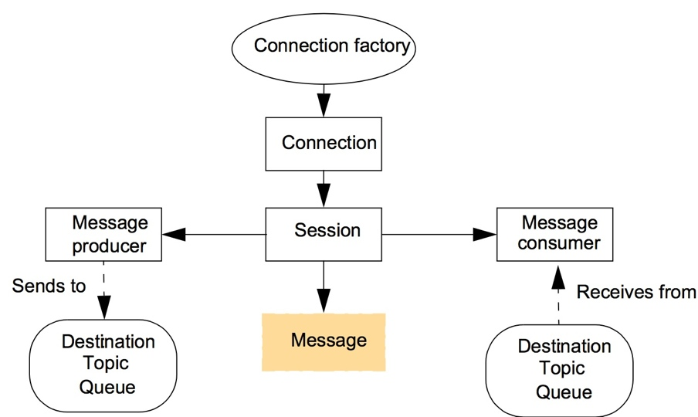
The programming model offered by JMS

Slide 64
JMS session objects
Message has 3 parts
Header: everything needed to identify & route msg
Destination, priroity, expiration date, message ID, timestamp
Properties: user-defined meta-data
Body: opaque data
Message producer: object that publishes messages to a topic or sends to a queue
Message consumer: subscribe to topics or receive from Q
Can associate filters w/consumer: specify a message selector
subset of SQL
Two modes for receiving messages
Block with receive operation
Create message listener object with a callback object onMessage

Slide 65
Java class FireAlarmJMS
// Usage: alarm.raise()
import javax.jms.*;
import javax.naming.*;
public class FireAlarmJMS { // more complex than Jgroups: create connection, session, publisher, message
// Lines 2-5 find the right connection factory and topic with JNDI (Lines 2-5)
public void raise() {
try { 1
Context ctx = new InitialContext(); 2
TopicConnectionFactory topicFactory = 3
(TopicConnectionFactory)ctx.lookup ("TopicConnectionFactory"); 4
Topic topic = (Topic)ctx.lookup("Alarms"); 5
TopicConnection topicConn = 6
topicConnectionFactory.createTopicConnection(); 7
TopicSession topicSess = topicConn.createTopicSession(false, // false means not transactional 8
Session.AUTO_ACKNOWLEDGE); // session ACKS msg receipt 9
TopicPublisher topicPub = topicSess.createPublisher(topic); 10;
TextMessage msg = topicSess.createTextMessage(); 11
msg.setText("Fire!"); 12
topicPub.publish(message); 13
} catch (Exception e) { 14
} 15
}

Slide 66
Java class FireAlarmConsumerJMS
import javax.jms.*; import javax.naming.*;
public class FireAlarmConsumerJMS // similar to producer!
public String await() {
try { 1
Context ctx = new InitialContext(); 2
TopicConnectionFactory topicFactory = 3
(TopicConnectionFactory)ctx.lookup("TopicConnectionFactory"); 4
Topic topic = (Topic)ctx.lookup("Alarms"); 5
TopicConnection topicConn = 6
topicConnectionFactory.createTopicConnection(); 7
TopicSession topicSess = topicConn.createTopicSession(false, 8
Session.AUTO_ACKNOWLEDGE); 9
TopicSubscriber topicSub = topicSess.createSubscriber(topic); 10
topicSub.start(); 11
TextMessage msg = (TextMessage) topicSub.receive(); 12
return msg.getText(); 13
} catch (Exception e) { 14
return null; 15
}16
} // await()
} // FireAlarmConsumerJMS – this missing in book!

Slide 67
Shared memory approaches
Abstraction: memory locations then tuple space
Distributed shared memory (DSM)
Read and write with API “like” ordinary memory
Updates propagated by the runtime system of the DSM
Mostly for parallel apps or if data items can be directly accessed
Not as appropriate for client-server
Replicas of data kept & managed (problems: replication, caching)
Can be very useful in non-uniform access (NUMA) parallel comp’s
Memory space can be persistent

Slide 68
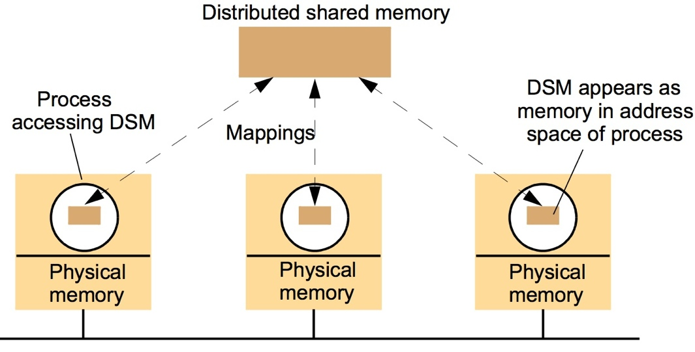
The distributed shared memory abstraction

Slide 69
Message passing (MP) compared to DSM
Both are lower-level than client-server or pub-sub
Service offered
MP:
variables have to be marshalled by apps
Producers and consumers protected from each other (no shared memory)
DSM:
No marshalling
Supports pointers
No app-level synchronization: DSM runtime takes care of
Persistent DSM supports temporal decoupling
Efficiency
DSM peformance varies widely, including access patterns
DSM can hide the fact that something is remote

Slide 70
Tuple space communication
A tuple is an ordered list of type values
Tuple space is an (unordered) bag of tuple
Can withdraw based on a specified value (or any value)
Primitives added
out(“Subtask”, velocity, i, j, k)
in(“subtask”, ?myVelocity, ?row, 3, ?factor)
rd(“subtask”, ?myVelocity, ?row, 3, ?factor)

Slide 71
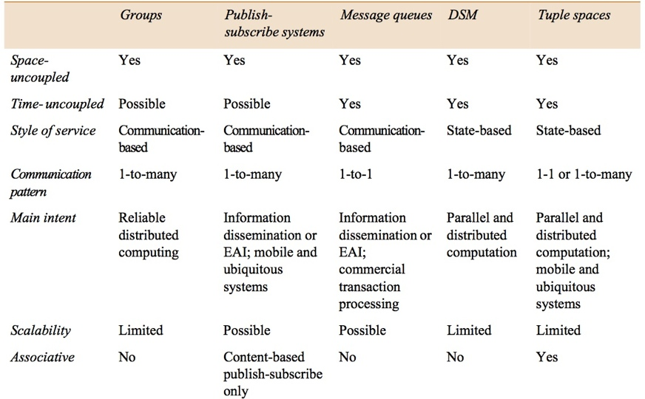
Summary of indirect communication styles

